Slide 1


Padlet Link:
Password:
PHY2004

Slide 2

PHY2004: Electromagnetism and Optics
Feedback: Key points
(Thank you!)
A bit too fast
Powerpoint slides – good
Filling in the equations is distracting
Example problems are good – where can we get more?
TEQs: https://qub.surveys.evasysplus.co.uk/
Dr. Charlotte Palmer/Prof. Gianluca Sarri

Slide 3
Full Maxwell’s equations – macroscopic form
Macroscopic form = equations in matter/simplified for accommodating bound charge
Integral form
Differential form
Relates fields in a region of space to fields on a boundary – useful for systems with symmetry
Calculating the local field at a point
Gauss’ law:
free charge density
Faraday’s law:
Ampere’s law:
free current
Dr. Charlotte Palmer/Prof. Gianluca Sarri
Notes:
Wikipedia: When an electric field is applied to a dielectric material its molecules respond by forming microscopic electric dipoles – their atomic nuclei move a tiny distance in the direction of the field, while their electrons move a tiny distance in the opposite direction. This produces a macroscopic bound charge in the material even though all of the charges involved are bound to individual molecules. For example, if every molecule responds the same, similar to that shown in the figure, these tiny movements of charge combine to produce a layer of positive bound charge on one side of the material and a layer of negative charge on the other side. The bound charge is most conveniently described in terms of the polarization P of the material, its dipole moment per unit volume. If P is uniform, a macroscopic separation of charge is produced only at the surfaces where P enters and leaves the material. For non-uniform P, a charge is also produced in the bulk.^{[11]}
Somewhat similarly, in all materials the constituent atoms exhibit magnetic moments that are intrinsically linked to the angular momentum of the components of the atoms, most notably their electrons. The connection to angular momentum suggests the picture of an assembly of microscopic current loops. Outside the material, an assembly of such microscopic current loops is not different from a macroscopic current circulating around the material's surface, despite the fact that no individual charge is traveling a large distance. These bound currents can be described using the magnetization M.^{[12]}

Slide 4
PHY2004: Electromagnetism and Optics
Lecture 12:
Electromagnetic waves
Dr. Charlotte Palmer/Prof. Gianluca Sarri

Slide 5
Mathematical formalism
Starting with Faraday’s law:
Take the curl of both sides (remembering that curl is commutative):
On the right hand side, we have the curl of the magnetic field that from the
Maxwell-Ampere law, we know to be equal to:
We can express this entirely in terms of the electric field by substituting in for the current and the displacement field.
Conductivity of material relating current to E-field:
Displacement field:
Dr. Charlotte Palmer/Prof. Gianluca Sarri
Notes:
I’M REALLY CONFUSED BY THE MIXING OF E AND D AND H.
Starting with Faraday’s law we can take the curl of both sides - this is common practice to help change the form of equations – as we know if we do the same thing to both sides it’s still equivalent.
Looking at the result we can see something familiar – we can relate the curl of the magnetic field via Ampere’s law to the current.
This enables us to express the curl of the curl of the electric field in terms of only the electric field.

Slide 6
Mathematical formalism
We can express this equation in a more elegant manner by using a
vector identity:
Vector identity
In absence of external charges, charge density ρ=0, and therefore:
Gauss’s law:
Dr. Charlotte Palmer/Prof. Gianluca Sarri
Should it be epsilon 0?
Notes:
As always knowing your vector identities is super helpful and this enables us to simplify this expression and rearrange it into a form that is more familiar from other physical situations.
What’s the steps to get from the top equation to the middle one…
Do you recognize this type of equation?
There is an analogous process for the magnetic field – have a go.

Slide 7
Mathematical formalism
This leads to we then obtain:
Similar arguments can be applied (try!) to the magnetic field, giving
an analogous expression:
Which equation do we start with to find B or H?
Dr. Charlotte Palmer/Prof. Gianluca Sarri
Notes:
As always knowing your vector identities is super helpful and this enables us to simplify this expression and rearrange it into a form that is more familiar from other physical situations.
What’s the steps to get from the top equation to the middle one…
Do you recognize this type of equation?
There is an analogous process for the magnetic field – have a go. Get them to have a go in the lecture, first guessing which equation to start with.

Slide 8
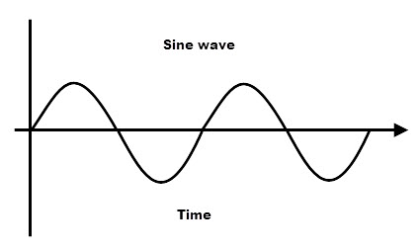
Mathematical formalism
If we have a perfect dielectric (conductivity σ = 0) then the equation reduces to:
This equation is formally identical to the general wave equation:
where Y is the disturbance propagating at a velocity ν (phase velocity of the wave).
Second derivative of Y with respect to t
Vector Laplacian operator:
Y
By comparison, we can see that the speed of the wave described by our expression is:
Dr. Charlotte Palmer/Prof. Gianluca Sarri
Notes:
If we’re considering a perfect dielectric which has zero conductivity we can simplify the equation as shown.
Zero conductivity means that the material cannot support currents – Electrons don’t flow through the material but they can be polarized – even the vacuum which is why the vacuum has it’s own vacuum permittivity
Looking at the components of the equation we see that we have this new operator called the spatial Laplacian operator on the right hand side. This is the second derivative.
Notes:
Wave equation is a homogeneous second order linear partial differential equation as you can set it equal to zero. This has standard solutions.
[Show the definition of permittivity].
Examples of perfect dielectric are the vacuum.

Slide 9
Speed of light
We have shown that electric (and magnetic) fields can propagate in the form of waves and that their velocity depends on the permeability and permittivity of the medium.
For propagation in vacuum we find:
This is an important result for several reasons:
This calculated value from Maxwell (1864), matched pretty well with measurements from Roemer (1676) and Bradley (1728) for the speed of light
This ties together electricity, magnetism and light into a single theory.
c is constant and as fundamental constants are unchanged in inertial reference frames this was all Einstein needed to formulate Special Relativity.
Looking at the phase velocity of the wave in other medium, we find it is slower than the speed in a vacuum (for most materials) and is dependent on the material properties (and frequency of light):
Dr. Charlotte Palmer/Prof. Gianluca Sarri
Notes:
Very important.
Links magnetic and electric fields and light. Studying circuits – rewriting the laws of the universe.
Leads to relativity because speed of light is fixed in a vacuum dependent on nothing.
Relativity principal that all observers must see the same laws of physics and physical constants are the same in all frames.
All observers see the same speed of light which means you have to have a relationship between space and time to preserve these.

Slide 10
Plane waves
Looking at the wave equation you can see that it is a linear, second order, homogeneous partial differential equation:
Partial Differential Equations:
Linear: derivatives are of first power of E with no cross terms.
Second order: highest derivative present is second derivatives.
Homogeneous: All terms include E or its derivatives (no sources).
This type of equation can have many solutions and these solutions can be linearly combined to create other solutions.
The second simplest solution is represented by the plane wave that reads:
Maximum amplitude of the wave
Complex form
Phase of wave
Dr. Charlotte Palmer/Prof. Gianluca Sarri
where c = ω/k is the phase velocity of the wave.
Any solution of that equation can be represented as a sum of (potentially infinite) plane waves. This is another extremely useful consequence of the Fourier theorem.
where c = ω/k is the phase velocity of the wave.
Notes:
WHAT ARE LINEAR PDES?
Maybe take care to use the word phase to describe the argument of the cosine and exponential (is this correct – discuss with Matt).
Wave equation is a homogeneous second order linear partial differential equation as you can set it equal to zero. This has standard solutions.
One is a cosine or sine wave which points in the x direction, and the other is

Slide 11
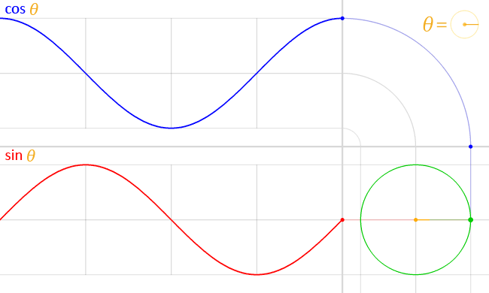
Complex form of wave equation solution
Maximum amplitude of the wave
Complex form
We will use Euler’s theorem to switch between these two forms so here’s a little refresher.
A complex number can be represented in polar or cartesian form:
Where: and
Using this form can make differentiation much easier/cleaner:
From Wikimedia Commons – L. Vieira
Dr. Charlotte Palmer/Prof. Gianluca Sarri
Notes:
Really great video definition of the derivation – follow this derivation on the slides.
https://www.youtube.com/watch?v=86eU7TKTr5U
IN THE ONLINE VIDEO HE HAS EXP(I(WT-KZ)) - DOES THIS MEAN MINE ARE THE WRONG WAY AROUND?

Slide 12
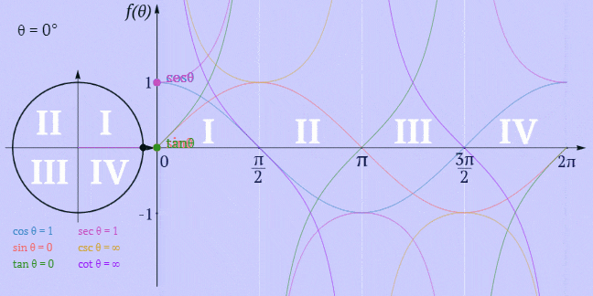
Complex form of wave equation solution
From Math Warehouse – Trigonometry Animated Gifs.
Dr. Charlotte Palmer/Prof. Gianluca Sarri
Notes:
Really great video definition of the derivation – follow this derivation on the slides.
https://www.youtube.com/watch?v=86eU7TKTr5U
IN THE ONLINE VIDEO HE HAS EXP(I(WT-KZ)) - DOES THIS MEAN MINE ARE THE WRONG WAY AROUND?

Slide 13
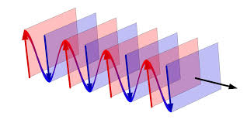
Plane waves
What does this look like if we visualize it:
Crests
You can see that it looks like a sine or cosine wave with amplitude varying along z and continue forever.
Troughs
Arrows of electric field
Notice that our Electric field is pointed along the x axis and flips direction every half wavelength.
Finally, along the y axis, the wave continues forever, it forms a plane with all the crests lined up.
Dr. Charlotte Palmer/Prof. Gianluca Sarri
Whilst extremely useful, one must be careful in introducing plane waves in physics since, strictly speaking, they are unphysical!
One can see that a plane wave has infinite extension in time (neither start nor end) and has an infinite extension in space. As a result, an infinite amount of energy must be associated with a plane wave.

Slide 14
Plane waves
What does this look like if we visualize it:
WARNING: It’s important to note that the plane wave is unphysical!
It has infinite extension in time (along the z axis) and in space (along the y-axis) so it would contain an infinite amount of energy!
BUT: Any solution of the wave equation can be represented as a sum of plane waves. The more plane waves we include, the shorter we can make our “super-positioned” final wave. This is a consequence of the Fourier theorem.
Crests
You can see that it looks like a sine or cosine wave with amplitude varying along z and continue forever.
Troughs
Arrows of electric field
Notice that our Electric field is pointed along the x axis and flips direction every half wavelength.
Finally, along the y axis, the wave continues forever, it forms a plane with all the crests lined up.
Dr. Charlotte Palmer/Prof. Gianluca Sarri
Whilst extremely useful, one must be careful in introducing plane waves in physics since, strictly speaking, they are unphysical!
One can see that a plane wave has infinite extension in time (neither start nor end) and has an infinite extension in space. As a result, an infinite amount of energy must be associated with a plane wave.

Slide 15
Electromagnetic waves
Taking our simple unphysical solution, the wave equation only features the electric field (or magnetic field) where the amplitude of our electric field is varying.
But we used Maxwell’s equations relating the electric and magnetic fields to derive this and we know that if we have a changing electric field or a changing magnetic field we’ll generate the other.
Try this by substituting the expression for E above into Faraday’s law.
You’ll retrieve a similar expression for B or H.
BUT the vector direction of the magnetic field will be perpendicular to E and to the direction of travel of the wave (along z) – these are TRANSVERSE WAVES.
Use your right-hand rule to check that they will have the relative orientation shown on the right.
Dr. Charlotte Palmer/Prof. Gianluca Sarri

Slide 16
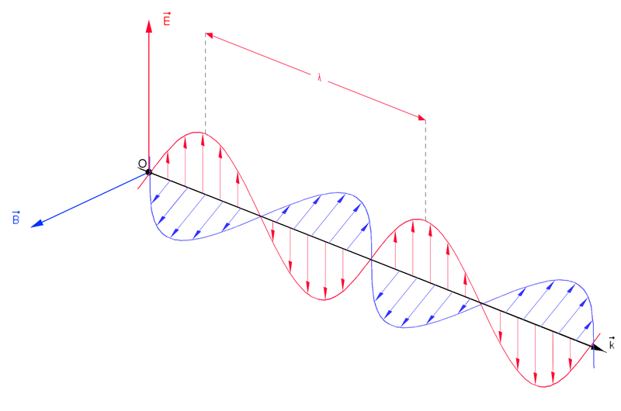
Electromagnetic waves
With both the electric and magnetic fields oscillating in-phase we have the structure that you see below.
When E and B are in-phase, the phase terms of both will be equal. We represent a phase shift by adding 𝜑 to the argument of the wave..
Phase of wave
From Wikipedia – Wave
This is a particular example of a linearly polarized plane wave. You’ll be learning more about polarization in the last third of the course.
Dr. Charlotte Palmer/Prof. Gianluca Sarri

Slide 17
Wave vector and frequency
Looking at this sketch of axes again you’ll notice that the axis along which the wave is propagating is also assigned a vector k, the wavevector, and so really we should treat it as a vector.
We know that we always have:
And in the absence of charges:
perpendicular vectors
Show the same is true for the magnetic field.
The magnitude of the wavevector is often called the wavenumber and is inversely proportional to the wavelength, 𝜆, of the wave.
Units of inverse length
From Wikipedia – Wave
Dr. Charlotte Palmer/Prof. Gianluca Sarri

Slide 18
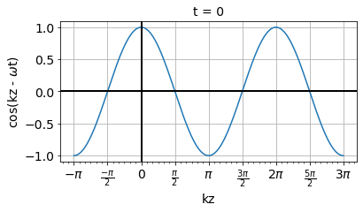
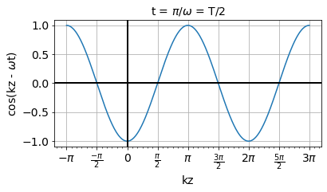
Phase velocity (again)
Both the wavenumber and the angular frequency of the wave appear inside the phase term in our mathematical expression for the wave.
Phase of wave - dimensionless
This argument represents where we are in our wave – we are travelling with the wave.
This argument represents where we are in our wave:
Crest of the wave
Trough of the wave
After time T/2
The velocity with which a fixed phase point on our wave propagates is called the phase velocity and it is equal to - this is also called ‘the speed of light’.
Dr. Charlotte Palmer/Prof. Gianluca Sarri
But this is a snapshot of our electric field – we know it is propagating to increasing z. We know that in time period, T, our wave will have propagated distance, 𝜆, so our velocity is 𝜆/T.
In our definition of a plane wave k is called the wave-vector. Its direction corresponds to the wave propagation axis, whilst its modulus is given by k=2π/λ with λ the wavelength of the wave. On the other hand, ω is the frequency of the wave, given by ω = 2π/T, with T the period.
The ratio between these two quantities is called the phase velocity of the wave and it represents the speed at which one phase front of the wave propagates

Slide 19
Refractive index
We know that the speed of light in vacuum is given by:
whilst in a medium it is given by:
The ratio of the speeds is which is called the refractive index of the material.
Note that since, in the optical frequency region (𝜆 : 400-700 nm), μ_{r} ~ 1, this is usually simplified to :
But importantly, remember the phase velocity in a medium is dependent on the frequency of the light, because the permittivity of a material is not constant – we’ll do more on this in a couple of lectures time.
The refractive index is a great tool to determine how light behaves when it propagates between media. You’ll look at this more in the optics section.
Dr. Charlotte Palmer/Prof. Gianluca Sarri

